Slide 1
The Doctor

Slide 2
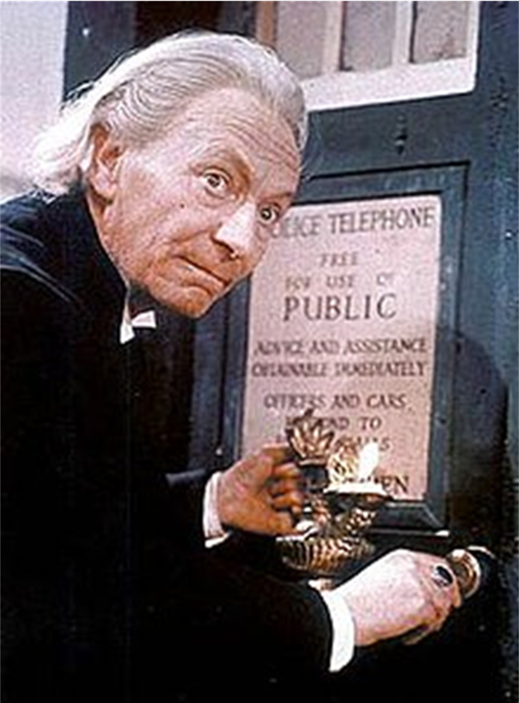
The First Doctor
Actor: William Hartnell
Seasons: 4
Stories: 29
Episodes: 134
Years: 1963-1966

Slide 3
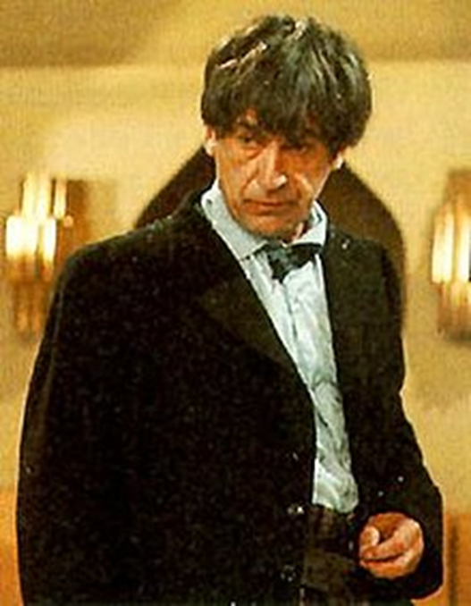
The Second Doctor
Actor: Patrick Troughton
Seasons: 3
Stories: 21
Episodes: 119
Years: 1966-1969

Slide 4
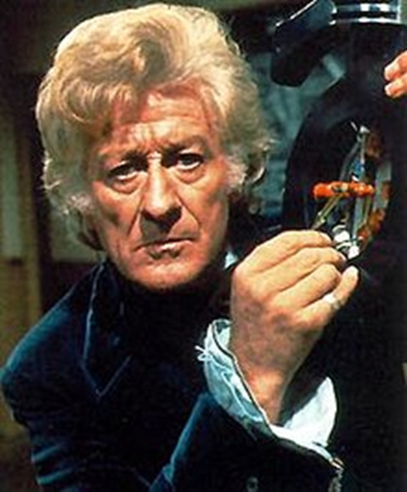
The Third Doctor
Actor: Jon Pertwee
Seasons: 5
Stories: 24
Episodes: 128
Years: 1970-1974

Slide 5
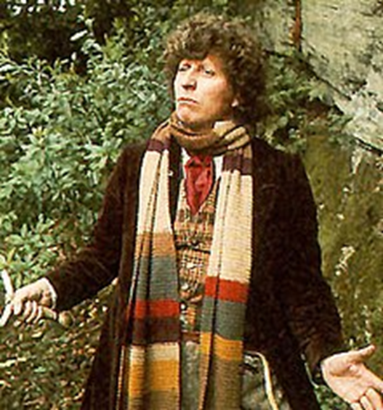
The Fourth Doctor
Actor: Tom Baker
Seasons: 7
Stories: 41
Episodes: 172
Years: 1974-1981

Slide 6
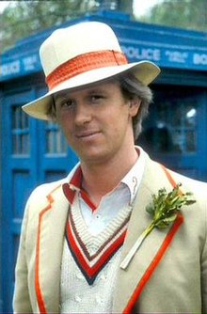
The Fifth Doctor
Actor: Peter Davison
Seasons: 3
Stories: 20
Episodes: 69
Years: 1982-1984

Slide 7
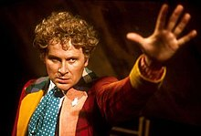
The Sixth Doctor
Actor: Colin Baker
Seasons: 3
Stories: 8
Episodes: 31
Years: 1984-1986

Slide 8
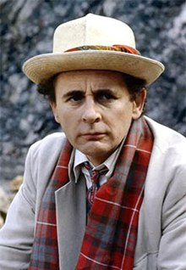
The Seventh Doctor
Actor: Sylvester McCoy
Seasons: 3
Stories: 12
Episodes: 42
Years: 1987-1989

Slide 9
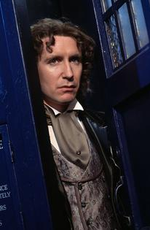
The Eighth Doctor
Actor: Paul McGann
Seasons: 1
Stories: 2
Episodes: 2
Years: 1966

Slide 10
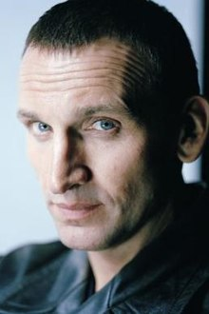
The Ninth Doctor
Actor: Christopher Eccleston
Seasons: 1
Stories: 10
Episodes: 13
Years: 2005

Slide 11
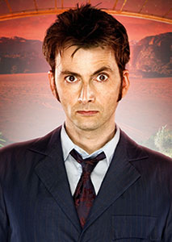
The Tenth Doctor
Actor: David Tennant
Seasons: 3
Stories: 36
Episodes: 47
Years: 2006-2010

Slide 12
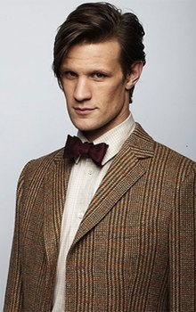
The Eleventh Doctor
Actor: Matt Smith
Seasons: 3
Stories: 39
Episodes: 44
Years: 2010-2013

Slide 13
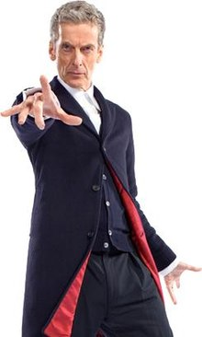
The Twelfth Doctor
Actor: Peter Capaldi
Seasons: 3
Stories: 35
Episodes: 40
Years: 2014-2017

Slide 14
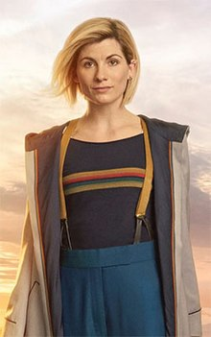
The Thirteenth Doctor
Actor: Jodie Whittaker
Seasons: 1
Stories: 11
Episodes: 11
Years: 2018-Current

